Slide 1
Lecture 6
Topics: Objects and Classes, Part II
Chapter 9, Sections 9.6 – 9.9

Slide 2
Using classes from the Java library
The Java library contains a rich set of classes for developing Java programs.
There is also a lot of documentation on these classes.
The Random class: https://docs.oracle.com/javase/8/docs/api/java/util/Random.html
The Date class: https://docs.oracle.com/javase/8/docs/api/java/util/Date.html

Slide 3

The Random class
In Programming I, we used Math.random() to generate random numbers.
The Random class is is both more efficient and less biased than Math.random().
java.util.Random
The Random class has two constructors – the default constructor which uses a default seed for generating random numbers and a constructor that lets you supply a seed (for consistency purposes).
Just like last lecture, we will need to use the constructors to create a random number object that can generate random numbers.

Slide 4
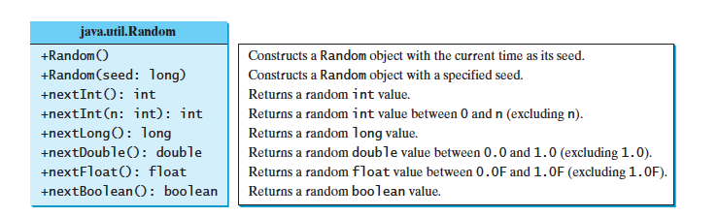
Random random1 = new Random(3);
System.out.print("From random1: ");
for (int i = 0; i < 10; i++)
System.out.print(random1.nextInt(1000) + " ");
Random random2 = new Random(3);
System.out.print("From random2: ");
for (int i = 0; i < 10; i++)
System.out.print(random2.nextInt(1000) + " ");
Notes:
A seed is a number used to initialize a random number generator so that the results are repeatable.
I.e. pseudo-random

Slide 5

The Date Class
java.util.Date
System-independent encapsulation of date and time.
Two constructors: A default constructor and a constructor that takes one argument.
Date(): Allocates a Date object and initializes it so that it represents the time at which it was allocated, measured to the nearest millisecond.
Date(long date): Allocates a Date object and initializes it to represent the specified number of milliseconds since the standard base time known as "the epoch", namely January 1, 1970, 00:00:00 GMT.

Slide 6
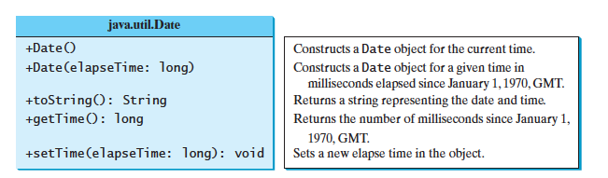
Date date = new Date();
System.out.println("The elapsed time since Jan 1, 1970 is " + date.getTime() + " milliseconds");
System.out.println(date.toString());

Slide 7
java.util.Date is...out of date!
If you look at the API for java.util.Date, you will see that most of the methods have been deprecated.
The Date class is still great for getting a basic time stamp (i.e. give me the date now!).
For date manipulations, the java.util.Calendar or java.util.GregorianCalendar are also out-of-date.
Java has introduced the Date-Time API, which has classes such as LocalDateTime, ZonedDateTime, etc.

Slide 8

But...
LocalDateTime only has a private constructor...and private members (instance variables, methods, constructors) cannot be accessed outside their class.
In fact, the Math class has a private constructor.
How do we use these classes if we do not have access to the constructor to make an object??

Slide 9
Static Variables
A static variable is shared by all objects/instances of the class.
This allows the objects to share data.
Static variables store values for the variables in a common memory location.
Because of this common location, if one object/instance changes the value of a static variable, all objects of the same class are affected.
A static variable is initialized only when the class is first loaded, NOT each time a new object is created.
A class is loaded because the JVM has decided to load it - typically because someone is trying to make a new instance of the class for the first time or use a static method or variable of the class.

Slide 10
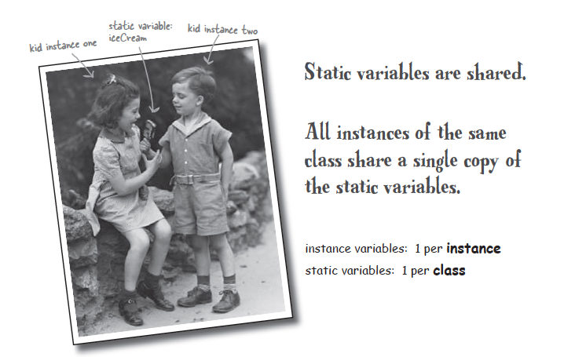

Slide 11
Why use static variables?
Imagine you wanted to count how many Duck objects you’ve created while your program is running. How would you do it?
public class Duck
{
private int size;
public Duck()
{
this.size = 30;
}
public Duck(int newSize)
{
this.size = newSize;
}
}
public class MakeANewDuck
{
public static void main(String[] args)
{
int duckCount = 0;
Duck defaultDuck = new Duck();
duckCount++;
Duck specialDuck = new Duck(22);
duckCount++;
}
}
If you had a lot of Duck
objects, this would get
old very fast. Not to mention repetitive!

Slide 12
What about putting duckCount in the constructors?
public class Duck
{
private int size;
public int duckCount = 0;
public Duck()
{
this.size = 30;
this.duckCount++;
}
public Duck(int newSize)
{
this.size = newSize;
this.duckCount++;
}
}
Whenever a new Duck object is made, the instance variable duckCount gets initialized to 0 and then increased by 1 for THAT object.

Slide 13
You can use static variables!
public class Duck
{
private int size;
public static int duckCount = 0;
public Duck()
{
this.size = 30;
duckCount++;
}
public Duck(int newSize)
{
this.size = newSize;
duckCount++;
}
}
public class MakeANewDuck
{
public static void main(String[] args)
{
Duck defaultDuck = new Duck();
System.out.println("Ducks: " + defaultDuck.duckCount);
Duck specialDuck = new Duck(22);
System.out.println("Ducks: " + defaultDuck.duckCount);
}
}
A Duck object does not keep its own copy of duckCount. and because it does not belong to an instance, you do not use the keyword this.
All Duck objects share a single copy of it.

Slide 14
When should I use a static variable instead of an instance variable?
A variable that is dependent on a specific instance of the class should be an instance variable.
A variable that is not dependent on a specific instance of the class should be a static variable.
Ex: The radius for a circle. Every circle has its own radius. Therefore, radius should be an instance variable.
Ex: The number of ducks that you create is not specific to a particular duck. Therefore, duckCount should be a static variable.

Slide 15

One more cool thing about static variables...
public class Duck
{
private int size;
public static int duckCount = 0;
public Duck()
{
this.size = 30;
duckCount++;
}
public Duck(int newSize)
{
this.size = newSize;
duckCount++;
}
}
You can access them without using the keyword new!!
public class MakeANewDuck
{
public static void main(String[] args)
{
System.out.println("Duck count is " + Duck.duckCount);
}
}
Notes:
Think of the static variables as belonging to the class.
Just a quick note - static variables can be abused, so you should use them sparingly.
Static methods are far more common.

Slide 16
Static Methods
Static methods follow a lot of the same rules that static variables do.
Static methods NEVER use instance variables (we’ll get to this!).
Because static methods do not use instance variables, you do not need to make an instance (i.e. create an object) of the class.
In fact, static methods cannot use non-static (i.e. instance) variables.
Static methods cannot use invoke/call/use other non-static methods.

Slide 17
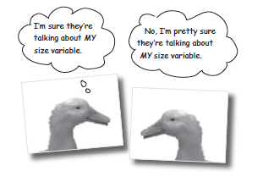
Why are static methods unable to use instance variables?
Static methods are associated with the class, NOT an object.
If you try to use an instance variable from inside a static method, the compiler thinks “I don’t know which object’s instance variable you’re talking about!”
If you have ten Duck objects, a static method doesn’t know about any of them.

Slide 18
Look what happens if you try to use an instance variable inside the most famous static method of all: main()

Slide 19
Why are static methods unable to use non-static methods?
What do non-static methods normally do?
They usually use instance variables to affect the behavior of the method.
Static methods do not depend on the object, they depend on the class.
Therefore, they are not allowed to be involved with things that are dependent on objects.

Slide 20
See what happens if you try to use a non-static method inside main()!

Slide 21
Static methods: Syntax
void, int, double, etc...
public static return_type nameOfMethod(formal parameters)
{
//Do Stuff!
}
Static methods can return values or nothing (i.e. void).

Slide 22


You’ve already used a class that has only static methods!

Slide 23
import java.lang.Math;

Slide 24

How do you use static methods?
Math.max(5, 10)
Name of class
dot!
Name of method

Slide 25
Visibility Modifiers
Visibility modifiers can be used to specify the visibility of a class and its members.
public: Denotes that the class, method or data field can be accessed from any other classes.
package-private: Denotes that the class, method, or data-field can be accessed by any class in the same package. This is the default modifier if no visibility modifier is used.
private: Makes methods and data fields accessible only from within their own class.
protected: TBD in a future lecture on inheritance and polymorphism!

Slide 26
Packages
Packages are used to organize classes.
If a class is created without the package statement, it is said to be placed in the default package.
All of the classes we have been creating up to this point have been placed in the default package because we did not use a package statement.
You have already been using classes from a package: System, String and Math all belong to the java.lang package. Scanner is in the package called java.util, which contains utility classes.

Slide 27
Remember: If the visibility modifier is not specified, it is protected.
package p1;
public class C1
{
public int x;
int y;
private int z;
public void m1() {}
void m2() {}
private void m3() {}
}
package p1;
public class C2
{
public void aMethod()
{
C1 o = new C1();
// Can access o.x
// Can access o.y
// Cannot access o.z
// Can invoke o.m1()
// Can invoke o.m2()
// Cannot invoke o.m3()
}
}
package p2;
public class C3
{
public void aMethod()
{
C1 o = new C1();
// Can access o.x
// Cannot access o.y
// Cannot access o.z
// Can invoke o.m1()
// Cannot invoke o.m2()
// Cannot invoke o.m3()
}
}

Slide 28


Encapsulation
Aka information hiding

Slide 29
What is information hiding?
Up until this very moment, we have been committing one of the worst OOP faux-pas: Exposing our data!
We are leaving our data out there in the world for ANYONE to see...and even touch or change!
You have been leaving your instance variables exposed by letting them be...(GASP!) public.
What does “exposed” mean? This means reachable with the dot operator.

Slide 30




Why is this bad?
object reference
object reference
couch.position = “left”
couch.position = “right”
Object (hangs out on the heap)

Slide 31
Hide the data!
How? With public and private access modifiers.
Starter rule of thumb: Make all your instance variables private.
Then use getters and setters to access the instance variables.
Getters and setters should be public.
Technically, getters and setters are just methods.
It is common to have only getters for properties and to initialize the properties using constructors.

Slide 32
Example
public class Duck
{
private int size;
public Duck()
{
this.size = 30;
}
public Duck(int newSize)
{
this.size = newSize;
}
public void setSize(int s)
{
this.size = s;
}
public int getSize()
{
return this.size;
}
}
This is called a setter (or mutator) method.
Setters are void methods.
This is called a getter (or accessor) method.
Getter methods return a value.
Now, in a different Java file, you can create Duck objects.
These Duck objects will have access to any public variables or methods.

Slide 33
Encapsulation Guidelines
Declare all the instance variables in the class as private.
Provide public getter methods to retrieve the data in an object.
Make any helping methods private.
Provide other public methods that the programmer will need for manipulating the data.
If the return type of a getter method is a boolean, the getter method should be defined as isPropertyName().

Slide 34
Example
(The Stock class) Create a class named Stock that contains:
A String data field named symbol for the stock’s symbol.
A String data field named name for the stock’s name.
A double data field named previousClosingPrice that stores the stock price for the previous day.
A double data field named currentPrice that stores the stock price for the current day.
A static int data field named stockCount that gets incremented in the constructor by 1 every time a Stock object is created.
A constructor that sets the symbol and name instance variables
Getters for the symbol, name, previousClosingPrice and currentPrice data fields.
Setters for the currentPrice and previousClosingPrice data fields.

Slide 35
UML Diagram
Stock
-symbol: String
-name: String
-previousClosingPrice: double
-currentPrice: double
+stockCount: int, static
+Stock(symbol: String, name: String)
+getSymbol() : String
+getName() : String
+setPreviousClosingPrice(price: double)
+getPreviousClosingPrice() : double
+setCurrentPrice(price: double)
+getCurrentPrice() : double

Slide 36
public class Stock
{
private String symbol;
private String name;
private double previousClosingPrice = 0.0;
private double currentPrice = 0.0;
public static int stockCount = 0;
public Stock(String symbol, String name)
{
this.symbol = symbol;
this.name = name;
stockCount++;
}
public String getSymbol()
{
return this.symbol;
}
public String getName()
{
return this.name;
}
public void setPreviousClosingPrice(double price)
{
this.previousClosingPrice = price;
}
. . . . .
}
. . . . .
public double getPreviousClosingPrice()
{
return this.previousClosingPrice;
}
public void setCurrentPrice(double price)
{
this.currentPrice = price;
}
public double getCurrentPrice(double price)
{
return this.currentPrice;
}
}

Slide 37

That’s all for today!

Slide 38
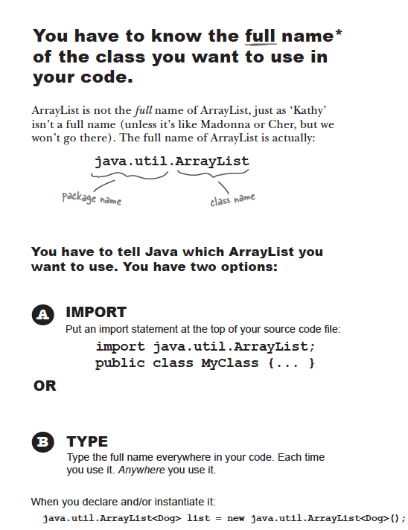
To import all the types contained in a particular
package, use the import statement with the
asterisk (*) wildcard character.
import graphics.*;
Now you can refer to any class or interface
in the graphics package by its simple name.
Circle myCircle = new Circle();
Rectangle myRectangle = new Rectangle();
Notes:
unless the class is in the java.lang package

Slide 39
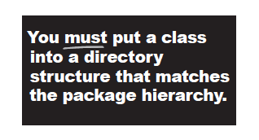
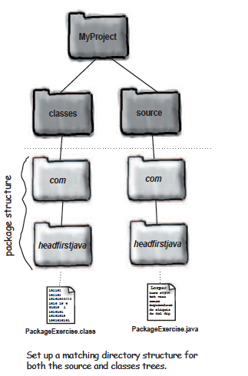
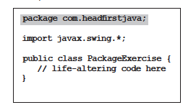
Note: Periods in a package name indicate folders!

Slide 40
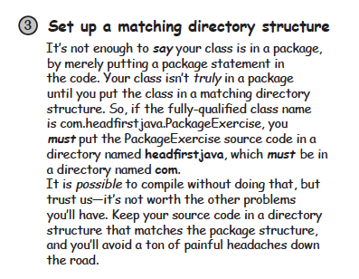
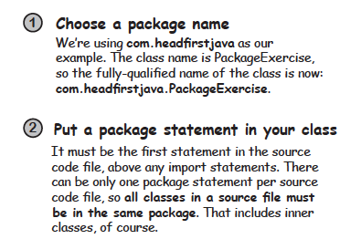
For those of you that are interested, there is are additional slides at the end of this lecture
that discusses how to compile and run your Java code (with packages) from the command line.

Slide 41
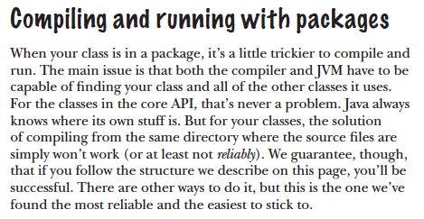

Slide 42
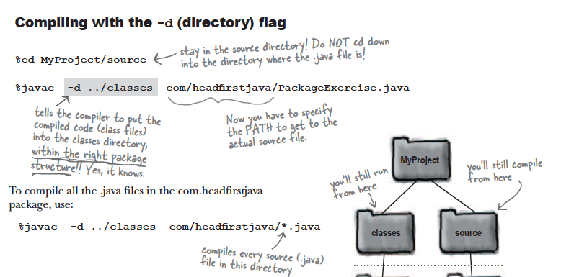
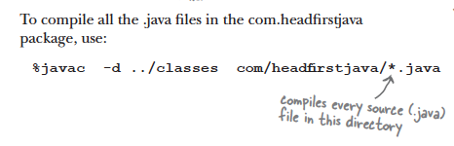

Slide 43
